Slide 1
Programming in Cognitive Science
Lecture 0: Why Cognitive Science Needs Programming

Slide 2
Learning Objectives
What is the value of computer programs in Cognitive Science?
What is a programming language, why are there so many, and what are the advantages and disadvantages of the Python language?
How do you get, install, and use Python?
What are some tools (like PyCharm) that make Python programming easier?

Slide 3
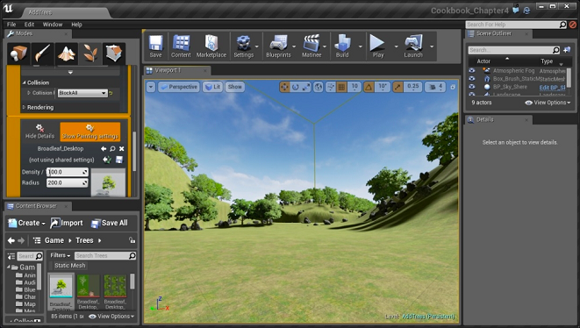
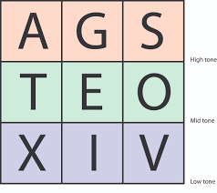
1.1 Value of Computer Programming
1. Data Acquisition (e.g. experiments, surveys, and games)

Slide 4
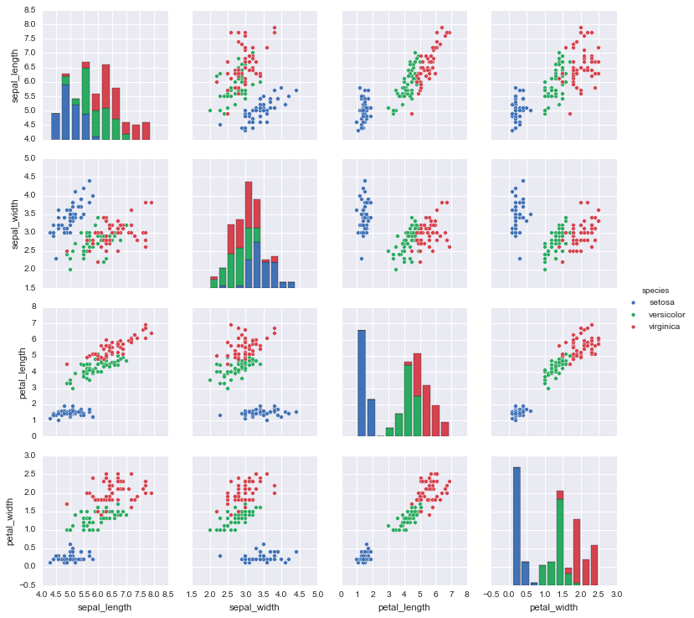

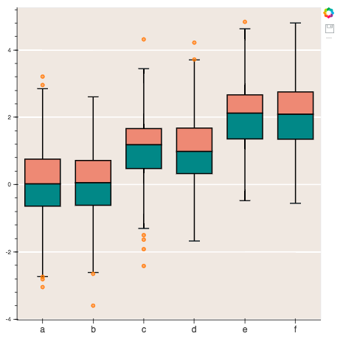
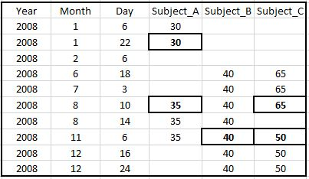
1.1 Value of Computer Programming
2. Data Manipulation, Analysis, and Visualization

Slide 5
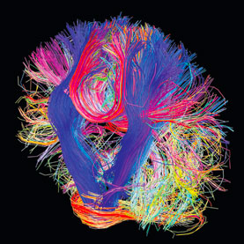
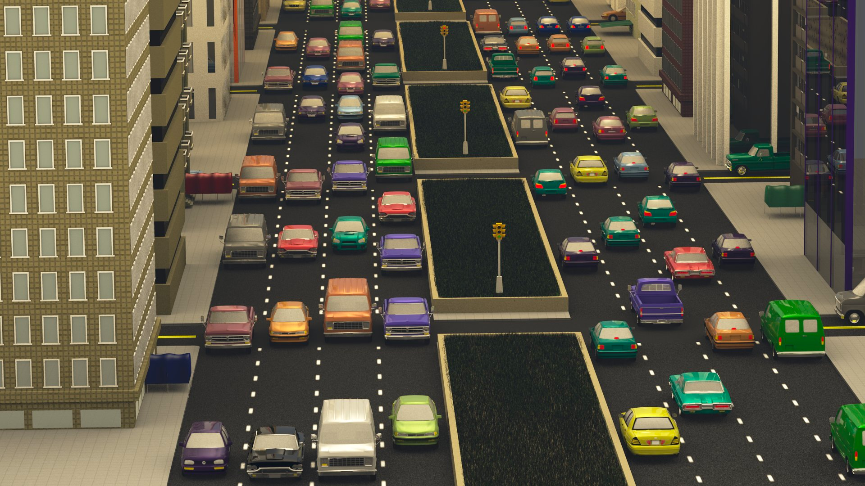
1.1 Value of Computer Programming
3. Simulation and Computational Modeling
Behavior Simulation (like traffic, why are there traffic jams when there arent accidents?
Brain Simulation

Slide 6

1.1 Value of Computer Programming
3. Simulation and Computational Modeling
We need simulations because:
they force us to be specific, to operationally define all the variables in our theories
complex behaviors (those involving 3+ interactions) cannot be studied well in any other way
three body problem: three variables whose behavior all depend on each other are noisy chaos.

Slide 7
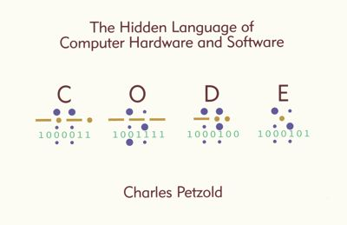
2.1 What is a Programming Language?
A programming language is a formal language that specifies a set of instructions that can be used to produce various kinds of output. Programming languages generally consist of instructions for a computer. Programming languages can be used to create programs that implement specific algorithms.
Programming languages (like all languages) have:
syntax – their form, or a system of rules that defines legal sequences
semantics – a meaning, requiring reference to the outside world.
Example:
A = “Hello”
B = ”World”
C = A + B
print(C) “HelloWorld”

Slide 8
2.2 Why Are There So Many Programming Languages?
Just like human languages, the syntax of programming languages make some things easy and other things hard.
Just like languages, they are tools, and different tools are good for different jobs.
For example, some languages can communicate directly with a computer's processor or memory. This makes them faster, but also harder to use.
Other languages are designed to be easy to high level languages that are easy to use. Code in these languages looks and sounds more like English, and so it is logical and sensible to newbies. But this often means eliminating details in ways that affect speed.

Slide 9
2.2 Why Are There So Many Programming Languages?
Consider this program that does simple addition.
How does a computer (or even a basic calculator) do addition?
To compute 3 + 4 in a computer:
Assign 3 to a specific memory register, which you access by stating its address, a hexidecimal number like 06GFE5153149A
Assign 4 to a different register with its own address 76GBE5153441C
Then assign a new address (12BF856DE23) the sum of what is stored in 06GFE5153149A and 76GBE5153441C
Seems easy enough, and your computer can execute this code very, very fast.
But you have to know your computer's memory addresses, and what's stored in them.
What if 06GFE5153149A is being used to store the information in your email, or your web browser, or the operating system.
Uh-oh, you just erased your data or broke your computer.
This is why almost nobody does this.

Slide 10
2.2 Why Are There So Many Programming Languages?
Consider this program that does simple addition.
How does a computer (or even a basic calculator) do addition?
To compute 3 + 4 in a computer:
Instead, use a “higher level” language (like MATLAB, or C, or Python, or Java, or …)
Type ”3+4”.
It prints out 7.
Nice!
Think about all the work it is doing under the surface.

Slide 11
2.3 Pros and Cons of Python
Pros
Free
Easy to learn
Easy to develop and test code - interactive
Easy to read other people’s code
Portable
Lots of users
Much code you can borrow
Many third-party modules that do stuff for you
Cons
Runs relatively slowly
Can be hard to debug
Limitations for graphics, mobile computing, database access

Slide 12
2.4 What We Will Cover
The Basics of Programming (in Python)
Data Structures (like strings, numbers, lists, sets, dictionaries, and tuple)
Functions
Classes
Good Programming Principles
Commenting code
Programming conventions
Writing understandable, sharable, and re-useable code
Applications to BCS
Processing, Analyzing, and Visualizing Data
Simulations & Computational Models
Creating Experiments (and Games)
Machine Learning and Artificial Intelligence
Natural Language Processing

